Slide 1


Associate Professor & Head
School of Management
Gangadhar Meher University

Slide 2
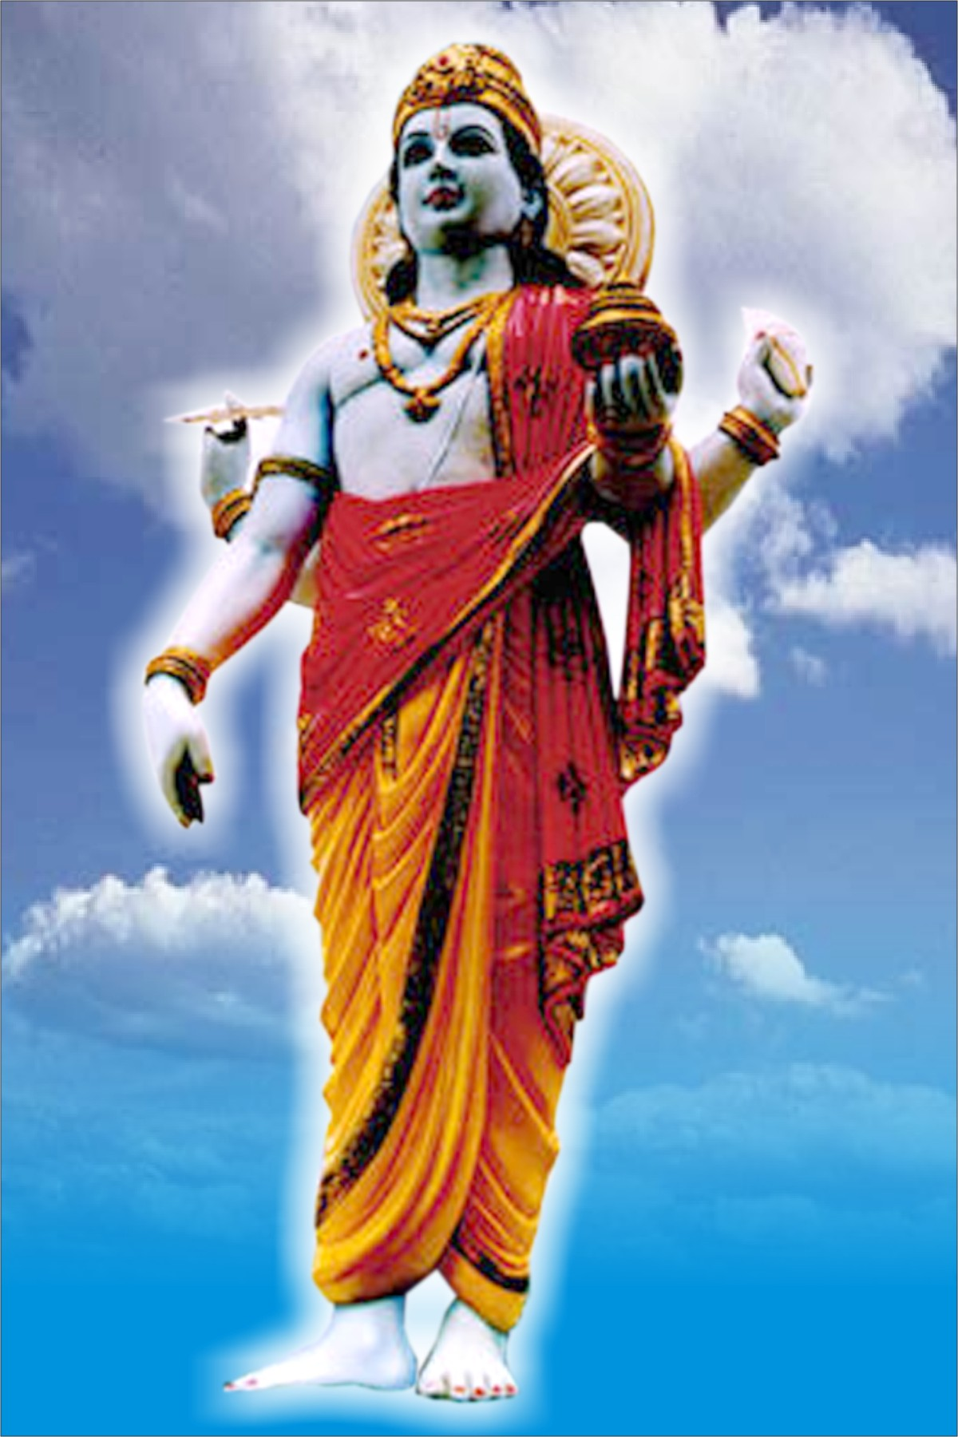

LORD DHANVANTRI THE GOD OF AYURVEDA WORSHIP ED BY HINDUS

Slide 3
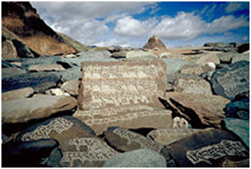
The mantra ॐ मणि पद्मे हूँ written on rocks. Chanting mantras has been a feature of ayurveda since the Atharvaveda, the vedic spiritual text, was compiled.
One view of the early history of ayurveda asserts that around 1500 BC, ayurveda's fundamental and applied principles got organised and enunciated. In this historical construction, Ayurveda traces its origins to the Vedas, Atharvaveda in particular, and is connected to Hindu religion. Atharvaveda (one of the four most ancient books of Indian knowledge, wisdom and culture) contains 114 hymns or formulations for the treatment of diseases. Ayurveda originated in and developed from these hymns. In this sense, ayurveda is considered by some to have divine origin. Indian medicine has a long history, and is one of the oldest organised systems of medicine

Slide 4
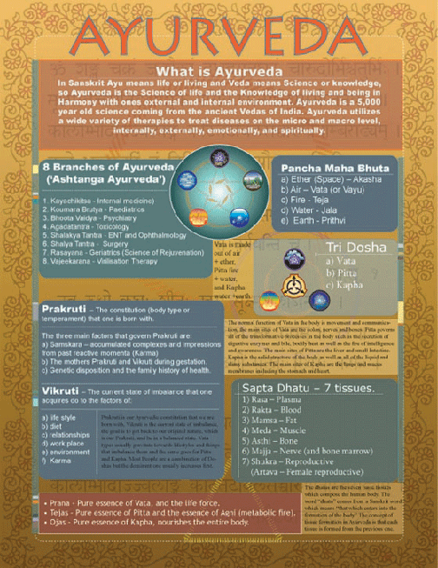
AYURVEDIC CHART

Slide 5

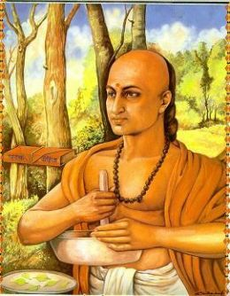
INTRODUCTION
The complete knowledge for long life is called AYURVEDA.
In SANSKRIT words “AYUS ” means “longevity” and “VEDA” means “related to knowledge” or “science”
Ayurveda medicine is a system of traditional medicine native to INDIA and a form of alternative medicine. Evolving throughout it’s history of medicine in South Asia
The earliest literature on INDIAN medical practice appeared during the VEDIC PERIOD in INDIA
In the middle second millennium, the SUSHRUTA SAHITYA and CHARAKHA SAHITYA are great encyclopedia of medicine compiled from various sources from mid 1st millennium to 500 CE

Slide 6

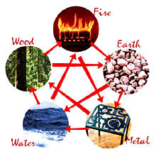
COMPOSITION OF
AYURVEDA
The Ayurveda is composed of 3 DOSAS and 5 ELEMENTS.
That 5 elements are Jala (water), Agni (fire), Vayu (air), Akasha (sky), Prithivi (earth) which compose the universe, including human body.
A.T. ayurveda Chyleorplasma (rasa dhatu), Blood (rakta dhatu), Flesh (masa dhatu), Fat (medha dhatu), Bone (asthi dhatu), Marrow (majja dhatu) & Semen or female reproductive tissue (sukra dhatu) are held to be the seven primary constitutient element – Sapta Dhatu of the body

Slide 7
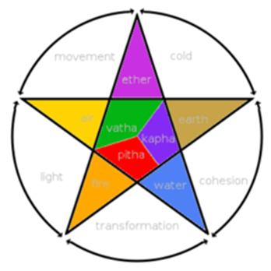
THE THREE DOSHAS AND FIVE ELEMENTS FROM WHICH AYURVEDA IS COMPOSED
Notes:
THE THREE DOSHAS AND FIVE ELEMENTS FROM WHICH AYURVEDA IS COMPOSED.

Slide 8
Ayurvedic literature deals elaborately with measures of healthful living during the entire span of life and its various phases.
Ayurveda stresses a balance of three elemental energies or humors: vāta (air & space – "wind"), pitta (fire & water – "bile") and kapha (water & earth – "phlegm").
According to ayurvedic medical theory, these three substances — doṣas (literally that which deteriorates)—are important for health, because when they exist in equal quantities, the body will be healthy, and when they are not in equal amounts, the body will be unhealthy in various ways.

Slide 9
In ayurveda, unlike the Sāṅkhya philosophical system, there are 20 fundamental qualities, guṇa (qualities) inherent in all substances.
Surgery and surgical instruments were employed from a very early period, Ayurvedic theory asserts that building a healthy metabolic system, attaining good digestion, and proper excretion leads to vitality.[9] Ayurveda also focuses on exercise, yoga, meditation, and massage.
The practice of pañcakarma is a therapeutic regime of purgation, sweating and massage that aims at eliminating toxic elements from the body.

Slide 10
“The science of eight components" a classification that became canonical for ayurveda. They are
Internal medicine (Kāya-cikitsā)
Paediatrics (Kaumārabhṛtyam)
Surgery (Śalya-cikitsā)
Eye and ENT (Śālākya tantra)
Fear possession (Bhūta vidyā): Bhūta vidyā has been called psychiatry.
Toxicology (Agadatantram)
Prevention diseases and improving immunity and rejuvenation (rasayana)
Aphrodisiacs and improving health of progeny (Vajikaranam)

Slide 11
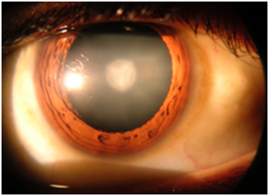
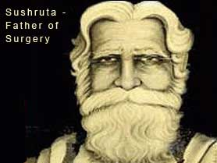
Cataract in human eye – magnified view seen on examination with a slit lamp. Cataract surgery was known to the physician Sushruta in the early centuries of the first millennium AD, and was performed with a special tool called the jabamukhi salaka, a curved needle used to loosen the obstructing phlegm and push it out of the field of vision.
The eye would later be soaked with warm butter and then bandaged.

Slide 12
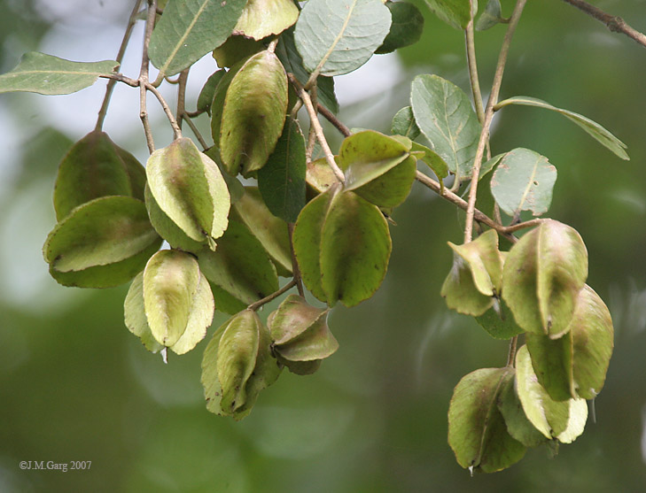


  Ayurveda stresses the use of plant-based medicines and treatments. Hundreds of plant-based medicines are employed, including cardamom and cinnamon.Some animal products may also be used, for example milk, bones, and gallstones. In addition, fats are used both for consumption and for external use.Minerals, including sulfur, arsenic, lead, copper sulfate and gold are also consumed as prescribed.This practice of adding minerals to herbal medicine is known as rasa shastra.

Slide 13



THE TOP AYURVEDIC
INSTITUTIONS IN
INDIA
Rajiv Gandhi University of health sciences, Bangalore
JB Roy state medical college, Kolkata;
State ayurvedic college, Hardwar;
National institute of Ayurveda, Jaipur;
Bharati vidhyapeeth, Pune;
Shri Ayurveda Mahavidhyalaya, Nagpur;
Government ayurvedic college, Raipur;
Gujarat ayurvedic University, Gujarat;
Rishikul state ayurvedic college, Pilibhit;
Dr. B R K R government ayurvedic college, Hyderabad;
Ayurvedic and unani tibia college, New Delhi

Slide 14




COMPANIES DEALING WITH AYURVEDA
THE COMPANIES DEALING WITH AYURVEDA ARE;
JIVA AYURVEDA
DABUR
AYUR
EMAMI

Slide 15

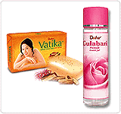
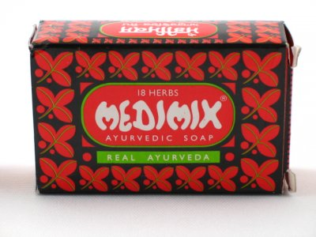
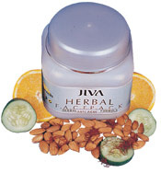


Slide 16


INDUSTRY - HEALTHCARE
HEADQUATERS - FARIDABAD,INDIA
AREA SERVED - WORLDWIDE
WEBSITE - JIVA.COM
JIVA AYURVEDA is an AYURVEDIC Company based in India. Founded in 1992,the company is headquartered in Faridabad,Haryana,is registered in the name of jiva ayurvedic pharmacy limited.jiva ayurveda was founded by AYURVEDIC DOCTOR,Dr.PRATAP CHAUHAN who is considered to be the pioneer of ayurvedic telemedicine.

Slide 17
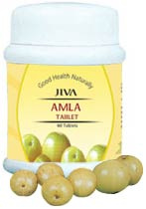



The company manufacturers ayurvedic medicines & products & provides health consultation through its Tele medicine centres,clinics & websities.

Slide 18
Type --- PUBLIC (NSE,BSE)
INDUSTRY---- HEALTHCARE,FOOD
FOUNDED ---- 1884
HQ --- DABUR TOWER, KAUSAMBI,GHAZIABAD(UP) INDIA.
FOUNDER(S)-- LATE DR.SK BURMAN
KEY PEOPLE -- DR ANAND BURMAN (CHAIRMAN)
DR AMIT BURMAN (V.CHAIRMAN)
MR SUNIL DUGGALE (CEO)
PRODUCT---- DABUR AMLA CHWANPRAS H ,VATIKA,HAZMOLA & REAL
NET INCOME--- (INR) 425cr (2008,2009)
EMPLOYEES---- 3000(APPROX)
DIVISION----- NEPAL,EGYPT,BANGLADESH,PAK.UAE
JAQULIN EINC.(USA)
SUBSIDIARIES---- DABUR INT. FEM CARE PHARMA,
NEWU.
WEBSITE-------DABUR .COM

Slide 19

Dabur (Devanagari: डाबर) derived from Daktar Burman is India's largest Ayurvedic medicine manufacturer. Dabur's Ayurvedic Specialities Division has over 260 medicines for treating a range of ailments and body conditions-from common cold to chronic paralysis.
In 2004, Dabur India Limited (Dabur) which started as a medicine manufacturer in 1884, was ranked at number four in terms of sales among the Fast Moving Consumer Goods (FMCG) companies in India.

Slide 20
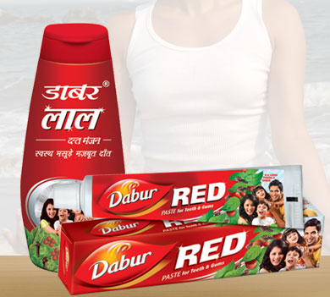

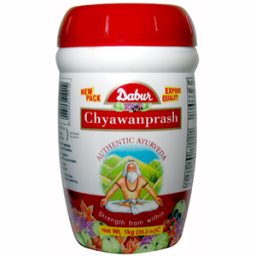
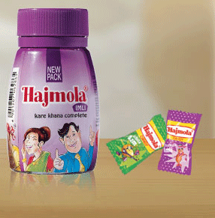
The company now has interests in hair care, health care, oral care and foods as well. Though its spread into various segments has ensured that the company's bottom-line has improved over the years, Dabur's positioning was not clear. In the early 2000s, the company went in for a restructuring which included aligning Dabur's brand architecture² with Dabur's brand equity³; pruning products that did not align with the brand architecture and launching new products.

Slide 21
Ayur is in herbal cosmetics business since 1984 &since it inception it has been a reflection of customer requirement.
With an objective to become one roof solution for all beauty & cosmetic problems, ayur provides a wide range of beauty cosmetics strictly repared by herbal components so that you look great without any ill effects on your skin & hair.
Ayur ensures, always, that the consumer gets his value for money & this is the most prominent reason behind ayur’s successful estb. In domestic market and increasing impact in other countries.

Slide 22

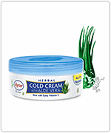
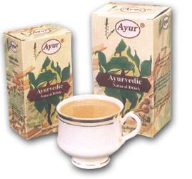
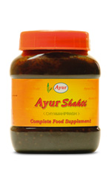
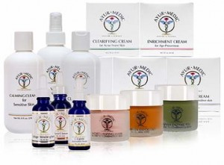

Slide 23

Industry---- FMCG
Founded---- 1974
Founders--- Mr. R.S.Agarwal & Mr. R.S.Goenka
H.Q ---- Kolkata, India
Products--- Hair care, skin creams, soap & lotion, talcum powder, Ayurvedic products
Revenue--- Rs.516 cr.(2006-07)
Website---- emamiltd.in

Slide 24
The inception of Emami Group took place way back in mid seventies when two childhood friends, Mr. R.S. Agarwal and Mr. R.S. Goenka left their high profile jobs to set up Kemco Chemicals, an Ayurvedic medicine and cosmetic manufacturing unit in Kolkata in 1974.
But against all odds with a vision of combining the age old wisdom of Ayurveda with modern manufacturing techniques for creating winning brands the company was started with a meager amount of Rs. 20,000. A dream of reaching out to the Indian middle class; a target audience who they thought will have increasing potential for consumption, the company started manufacturing cosmetic products as well as Ayurvedic medicines under the brand name of Emami from a small factory in Kolkata.

Slide 25
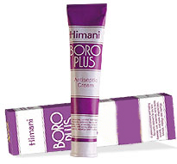

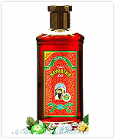
A chain of distributors was established and the sale of Emami products spread from West Bengal to rest of Eastern India and gradually to other states. Emami Talcum, Emami Vanishing Cream and Emami Cold Cream were great favorite brands with the quality conscious consumers in the mid-seventies. The company soon became adept in selling beautiful dreams to Indian women interested in finding their own identity.

Slide 26
ROLE OF AYURVEDA IN INDIAN TOURISM
For years these charming land of India has been known for its Ayurveda and Yoga .
Over the past few years, Ayurveda became an important part of Indian Tourism.
Ayurveda & Yoga tour packages aims at curing disease, revitalize energy & lead a healthy long life .
Indian Ayurveda tours offers to stay in the most popular resorts and spas from various groups of hotels .The hotels are authentic & recognized by tourism dept.
Finally the cost of our tour packages vary as per the nature accommodation & duration required during the Ayurvedic & Yoga tour.

Slide 27
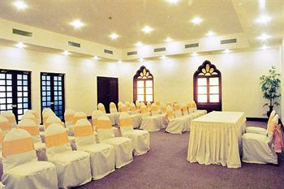
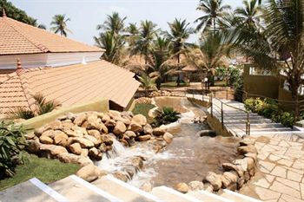
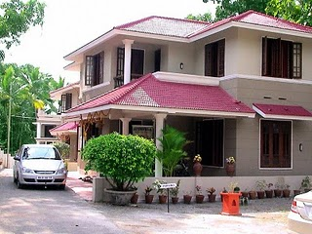
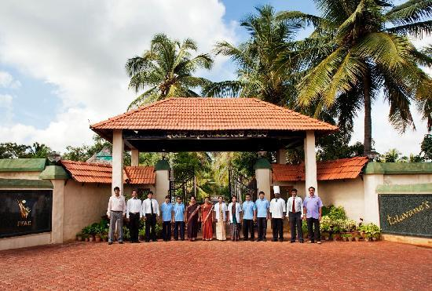

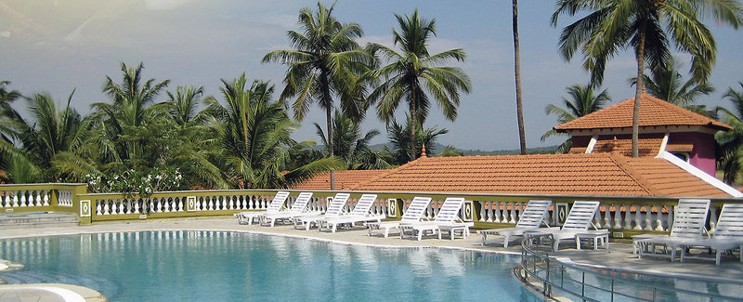

Slide 28
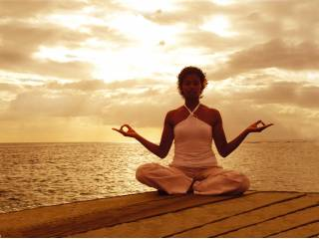
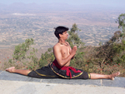


Slide 29
THANK YOU

